Slide 1
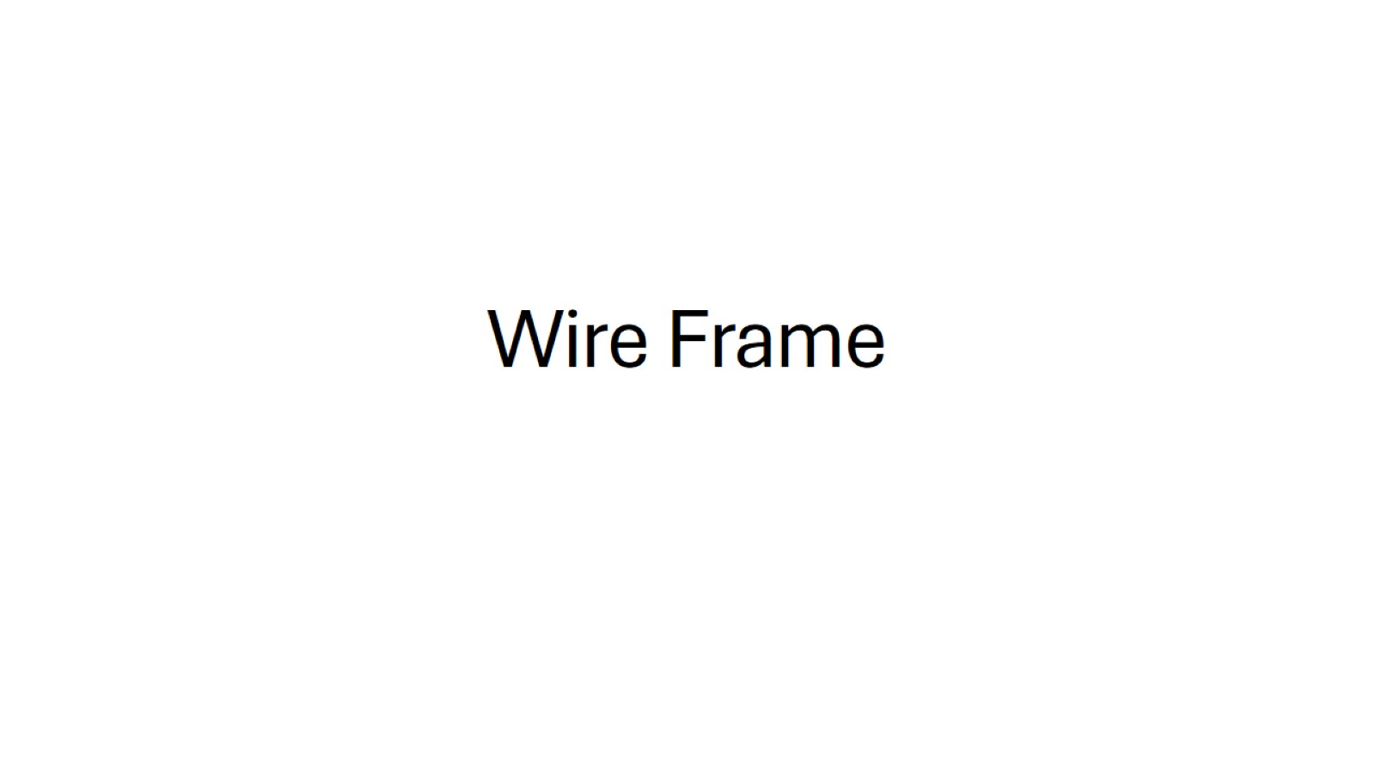
Wire Frame

Slide 2
